Slide 1

Why Study German?

Slide 2
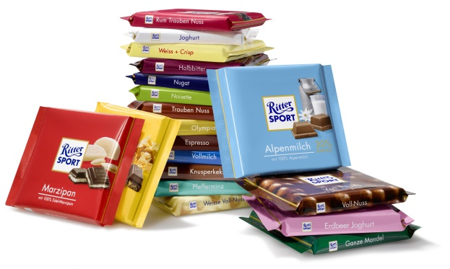




Germany was among the world's two biggest exporters in 2013 for an 11th consecutive year; for six of those years, it ranked #1, even ahead of China.

Slide 3

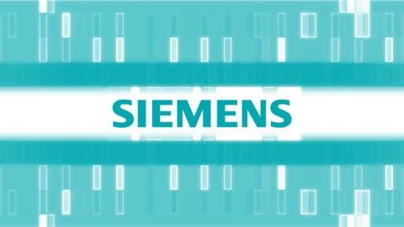

Knowing German creates business opportunities. More than 2,000 major American firms do business in German-speaking countries. More than 1,100 German companies do business in the US, providing an estimated 700,000 jobs for Americans.
Willy Brandt, a former German chancellor, once said: “If I’m selling to you, I speak your language. If I’m buying from you, dann müssen Sie Deutsch sprechen.”

Slide 4

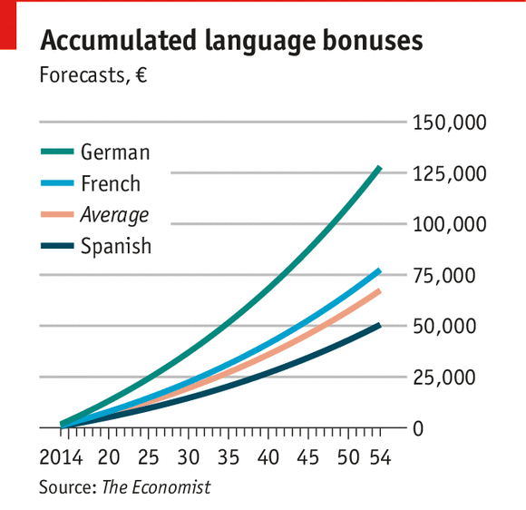

Knowing German can boost your annual salary in the US by 4%, in Europe by even more.

Slide 5

German is the Internet’s second language. 57% of the world’s websites in 2011 were in English, followed by 7% in German, 5% in Japanese, 5% in Chinese, and 4% in Spanish.

Slide 6



18% of all books published in the world are in German.

Slide 7
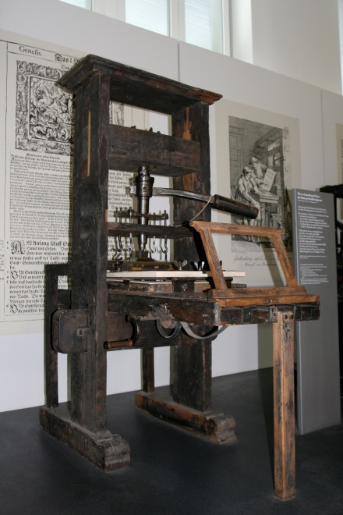

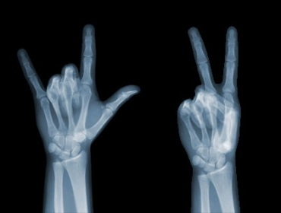
Throughout history, Germans have been innovators. Today, 4 of the world's 10 most innovative companies are located in Germany and at 12.7% of the world's patent applications, the country ranks 3rd in the world. More than 200,000 businesses introduce new high-tech products on the market each year.

Slide 8

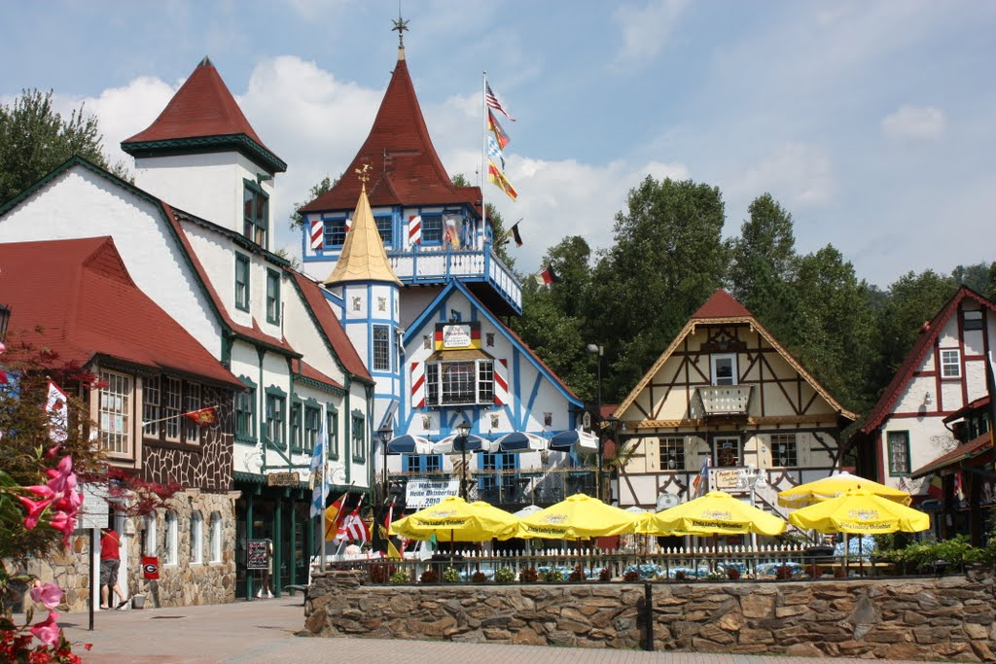
Almost 20% of all Americans claim German ancestry.
This heritage is felt throughout the country, in names like Brunswick, GA, in festivals like the Oktoberfest, in holiday traditions (Christmas tree, Easter Bunny, etc.), in words like kindergarten, angst, zeitgeist, and many more.

Slide 9
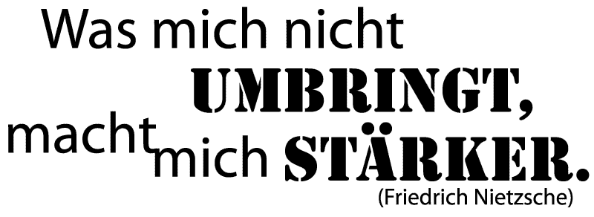

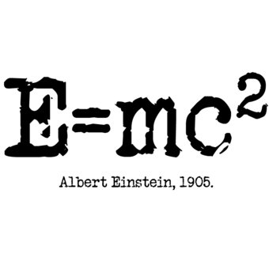
German is the language of Luther, Goethe, Nietzsche, Kafka, Mozart, Bach, Freud, Beethoven, and Einstein as well as many more influential authors and artists. Knowing German helps better understand their work.

Slide 10
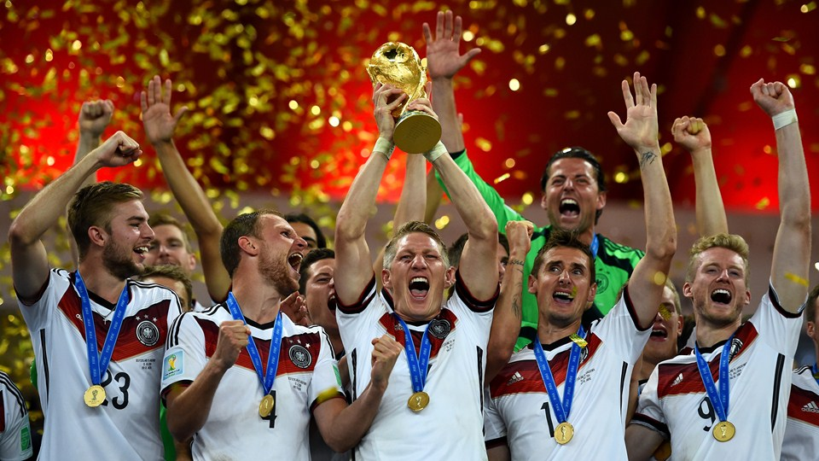
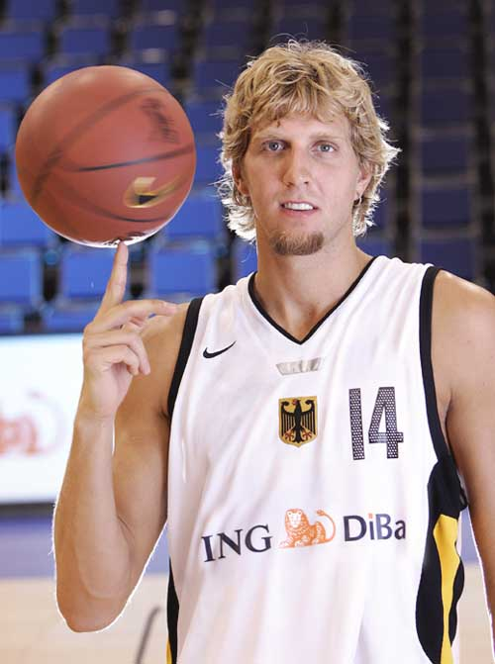



Deutschland ist Sportland!

Slide 11






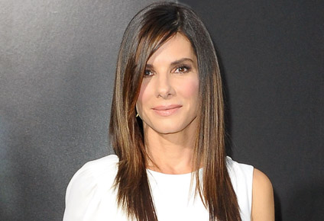
Deutschland ist Filmland!

Slide 12
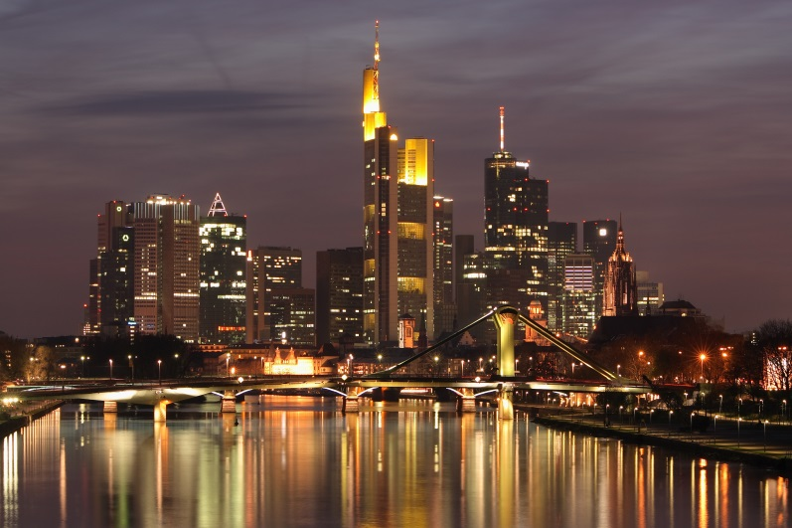
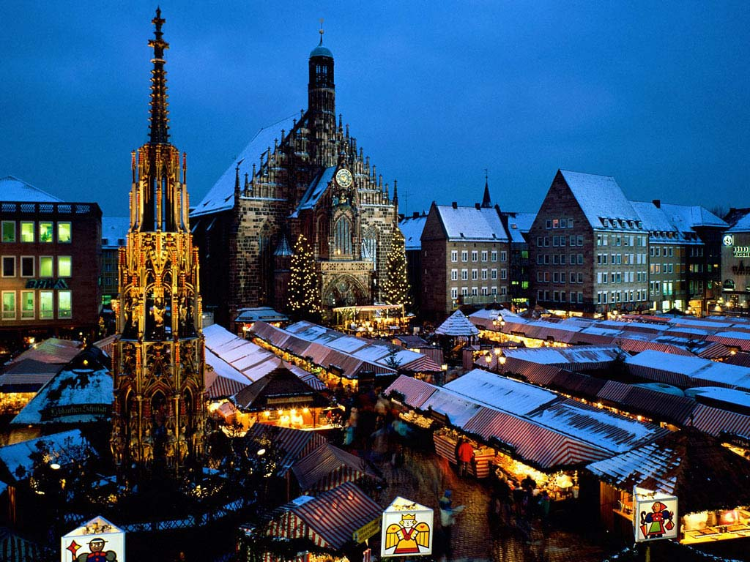


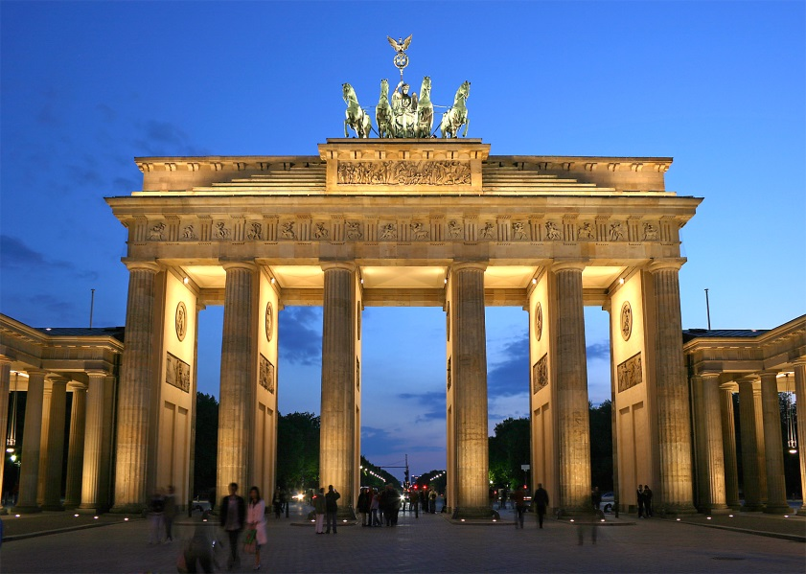

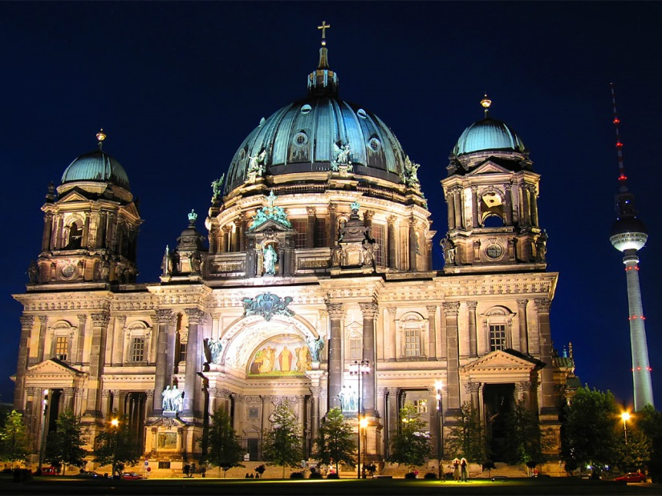
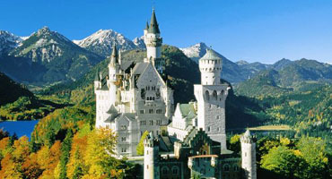
Deutschland ist wunderbar!

